Slide 1
RFFS in Austria

Slide 2
Ing. Andreas M. Herndler, MBA MPA
since 2009: Ministry of Transport, Emergency Planning (etc.)
since 1989: fire service of Krems/Danube
actual:
fire chief of Krems/Donau 900 interventions p.a., 110 members, 20 vehicles/boats
head of alarm center
chief of staff of provincial fire service
team leader of EU Civil Protection Mechanism

Slide 3
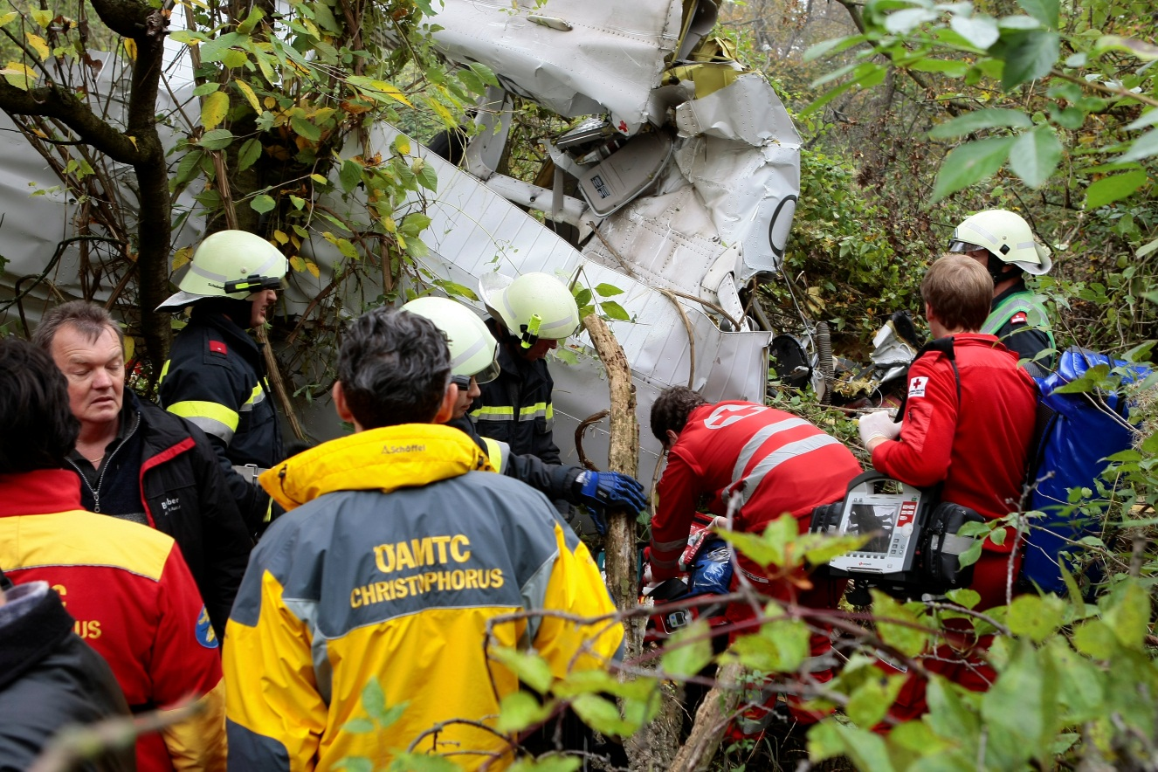
Where I come from …
airfield with mit 30.000 movements p.a.
2 – 3 crashes p.a.
20.10.2013:
1 x fatal
1 x injured

Slide 5
figures, data, facts, …
5 aerodromes
1 military aerodrome with civil usage
45 airfields
82 heliports

Slide 6
aerodromes under EASA-scope

Slide 7
aerodromes
aerodrome | passenger | freight
Graz | 930.000 | 1.400 to
Innsbruck | 930.000 | 270 to
Klagenfurt | 280.000 | 1 to
Linz | 620.000 | 4.900 to
Salzburg | 1.700.000 | 210 to
Vienna | 22.200.000 | 178.000 to

Slide 8
Categories – number of RFFS-personnel
Cat. 9 (optional to be raised to 10 on request)
Graz: part-time fire service with special processes and agreements
Linz: part-time + military fire service with special processes and agreements
Salzburg: part-time fire service with special processes and agreements
Vienna: professional fire service with special processes and agreements
Cat. 8
Innsbruck: part-time fire service with special processes and agreements
Klagenfurt: part-time fire service with special processes and agreements
No guidelines in respect of number of personnel -> task and risk analysis based!

Slide 9
RFFS requirements
only for aerodromes under EASA-scope (in respect of ICAO Annex 14)
number of vehicles
amount and discharge rate of extinguishing agent
response time (alarm test once a year)
full scale exercise every 2 years
partial exercise in between
no requirements for smaller airfields, at the discretion of local authority

Slide 10
aerodrome requirements
risk and task analysis
runway + safety strip + RESA + manoeuvring area
aerodrome
rescue area around aerodrome
emergency planning
provision of special equipment

Slide 11
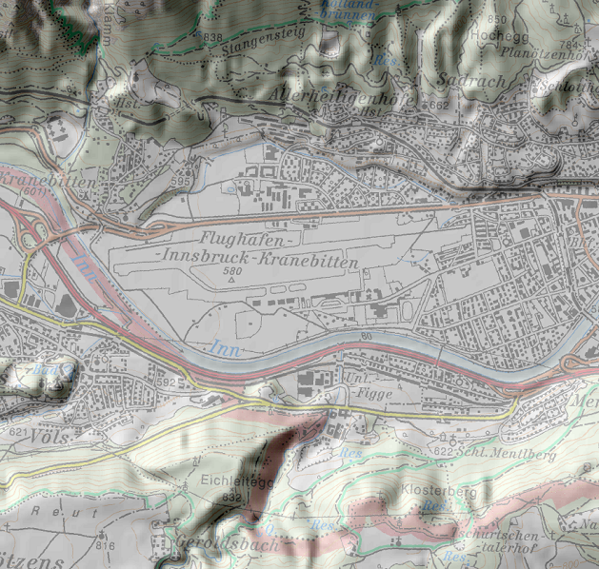
risk analysis
natural disaster
avalanches
flooding / mudflow
ground water
wind
technical disaster
aeronautical emergencies
ash cloud, CBRN, PHE, …

Slide 12
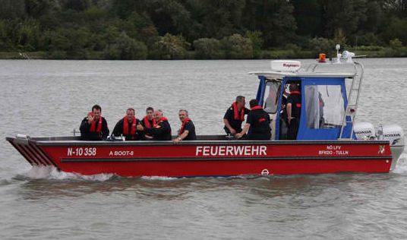
special equipment
Vienna
2 km of Danube in rescue area
flooding area of Danube km just behind RESA
cooperation with local fire services
amphibien vehicle

Slide 13
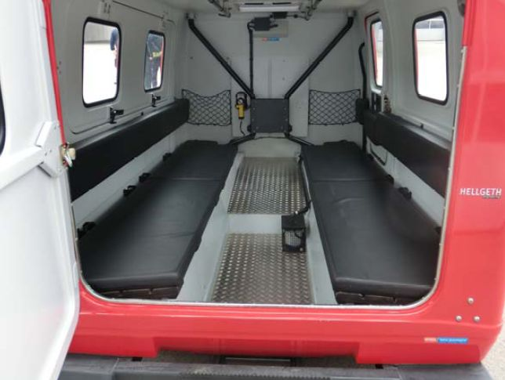
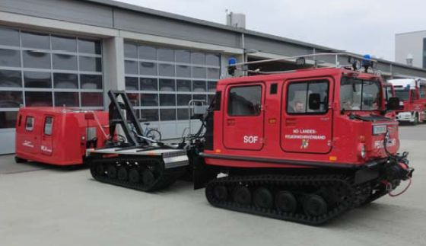

Slide 14
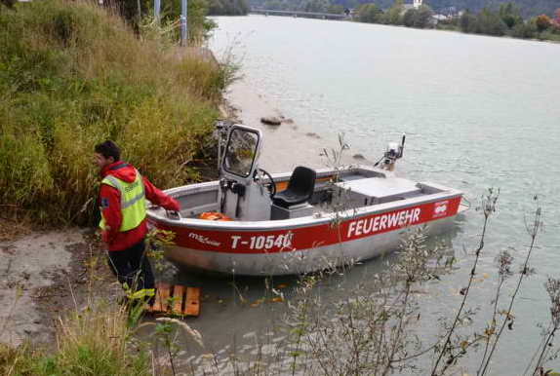
special equipment
Innsbruck
aluminium-hull
jet power unit
varying water-level
can´t be used 5 months p.a.

Slide 15
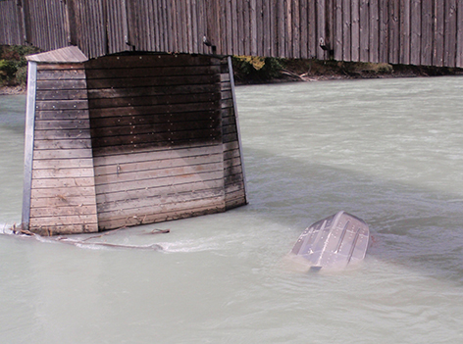
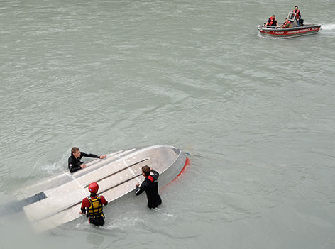
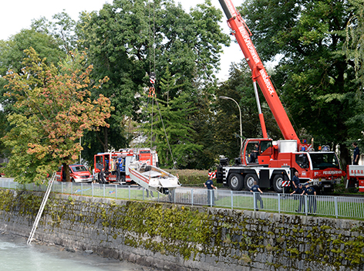

Slide 16
further development of RFFS requirements
working group of Austrian Fire Association
requirements for airfields
ballistic parachute systems
education for RFFS personnel on aerodromes

Slide 17
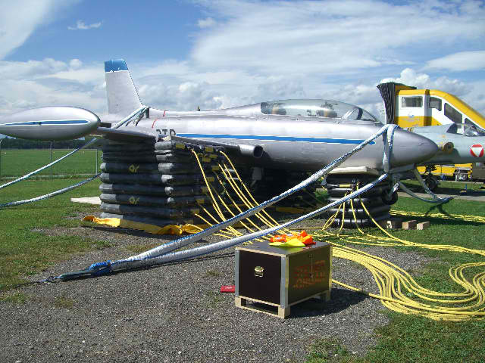
removal of disabled aircraft
Code D: all aerodromes
Code E: pool at Vienna
Code F: cooperation with ADV / Fraport

Slide 18
Ing. Andreas M. Herndler, MBA MPA
Akad. Krisen- und Katastrophenmanager
Federal Ministry of Transport, Innovation and Technology
Aerodromes - Infrastructure
Radetzkystreet 2, A-1030 Vienna
+43 1 71162-659812 - andreas.herndler@bmvit.gv.at

